Slide 1

Machine Learning Final Project
Classification work on architecture image with hierarchy
Team member ：Chao Fu, Yingjie Jiang, Yuanye Chi, Zhiyi Zhao

Slide 2
Agenda
Start From Image
Dataset Chosen
Convolutional Neural Network --- CNN
CNN Architecture
CNN Result
Hierarchical Deep CNN --- HD-CNN
Why HD-CNN
What HD-CNN Brings
Summary and Next Step

Slide 3




Database Chosen
We love traveling,
We love different culture,
We love stylish architecture,
But it’s not easily distinguished,
so, we found pictures of the major architectural styles in the world contains 10,113 images from 25 architectural styles including Postmodern, Romanesque, Gothic...

Slide 4

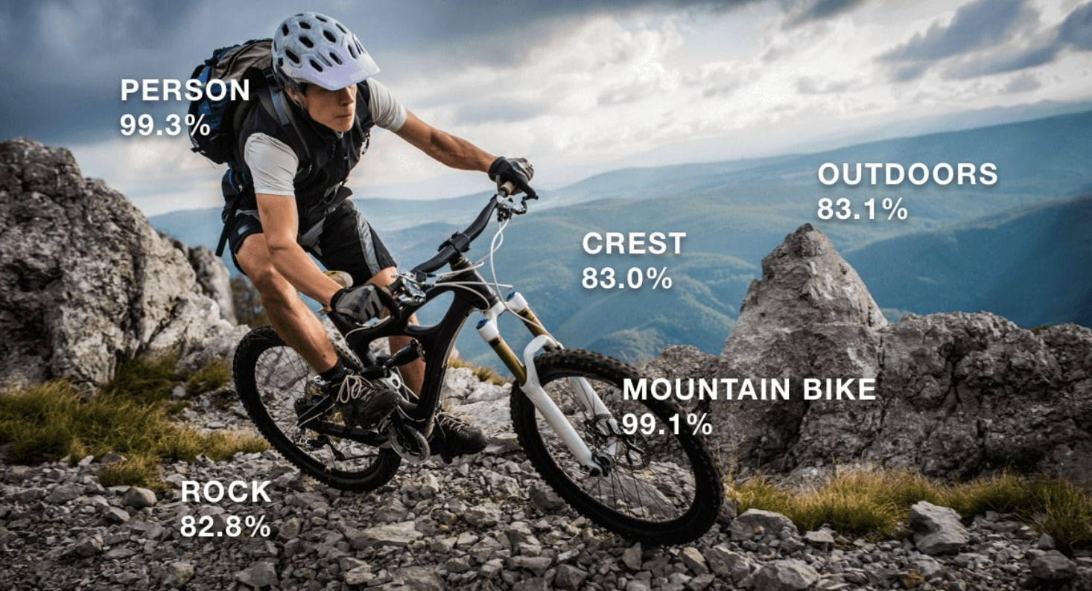
Start from Image

Slide 5
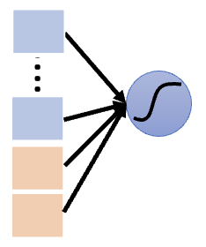
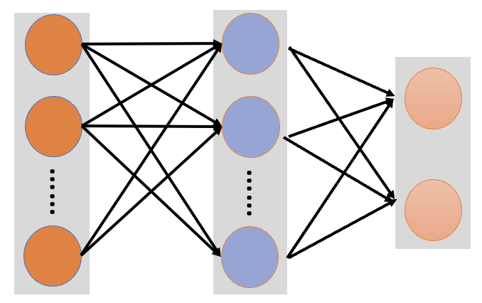

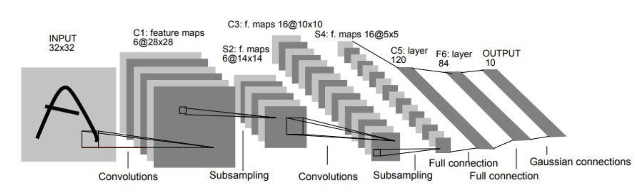


CNN Architecture
4 Conv layers
Double # of Fix size of Filters with 3*3
2*2 max pooling
2 Fully connected layers
3 channels
…...
tensor
3*3*64
3*3*512
Yann LeCun, L.on Bottou, Yoshua Bengio, and Patrick Haffner. Gradient-based learning applied to document recognition. Proceedings of the IEEE, 86(11):2278–2324, 1998.

Slide 6
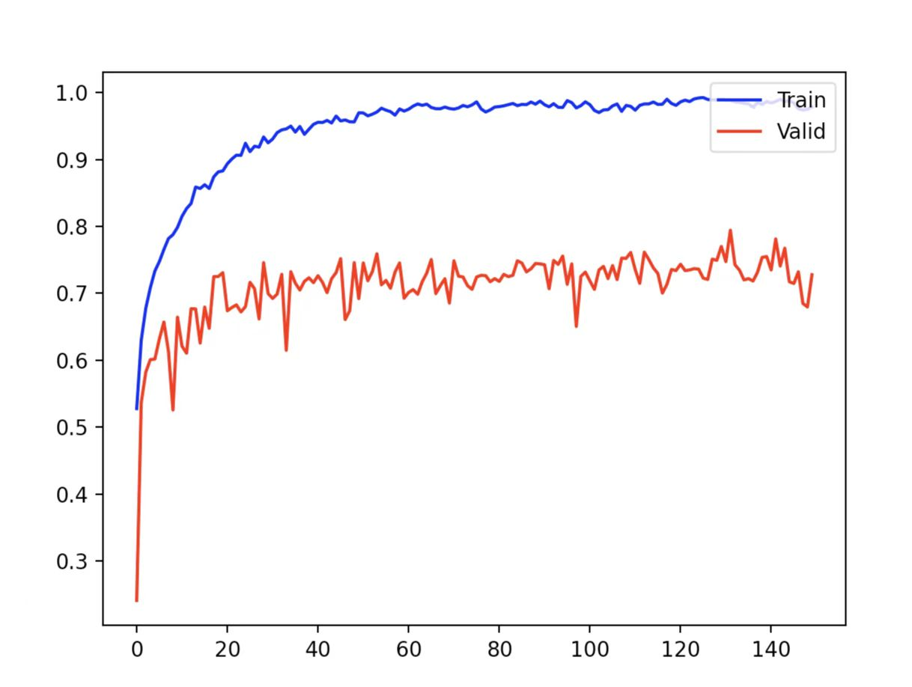

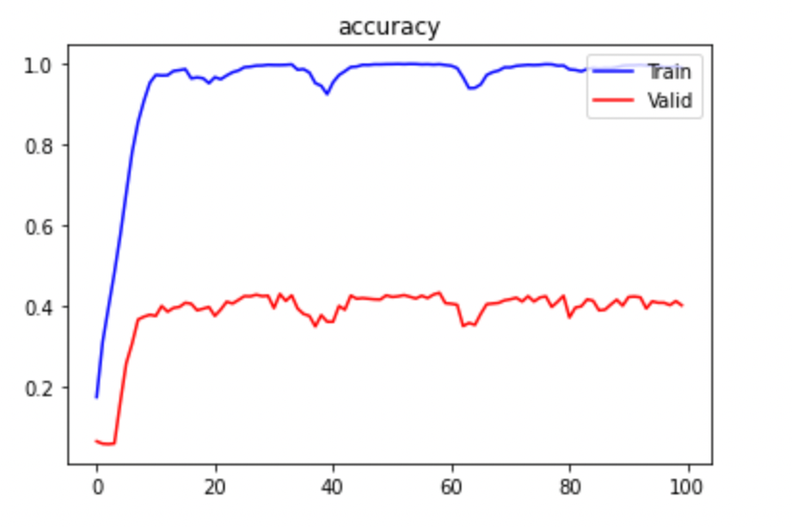
CNN Result
Several ways we tried to reach the best performance
Modify network architecture
4 layers is the safest to balance the performance and time consumption, also to avoid overfit
Parameters adjustment
4 classifier
Batch normalization
ReLU instead of Sigmoid
Dropout was used
Use Adam but not SGD
Dataset transform & augmentation
Crop, rotate and flip raw photos randomly
25 classifier

Slide 7
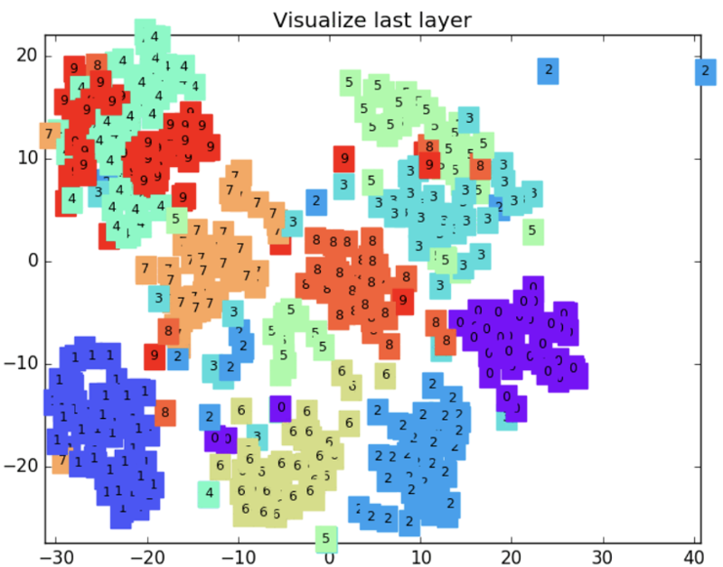
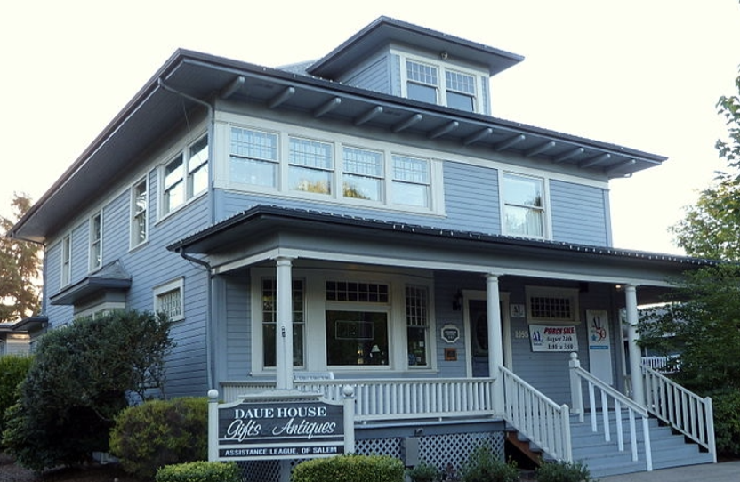
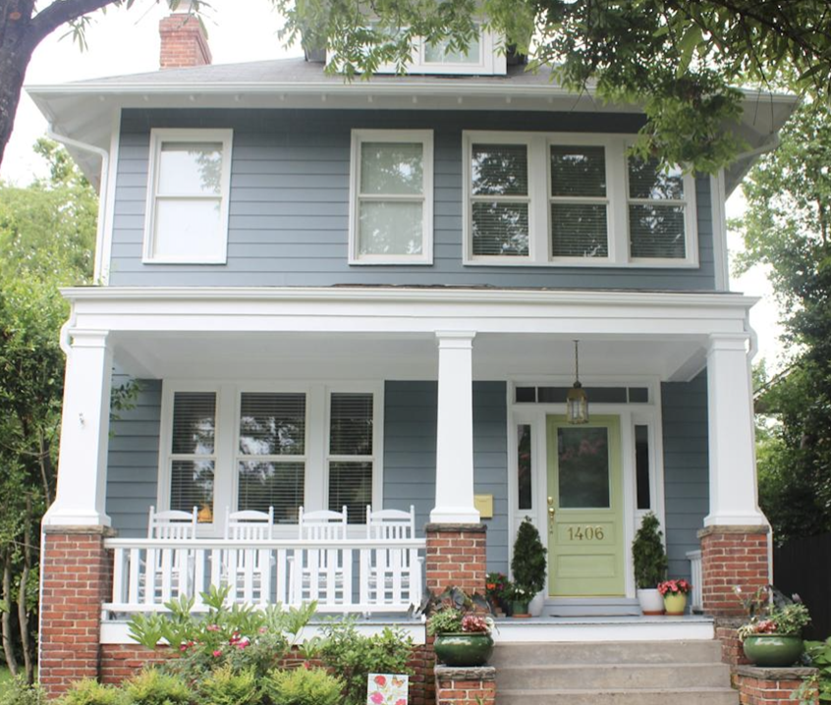
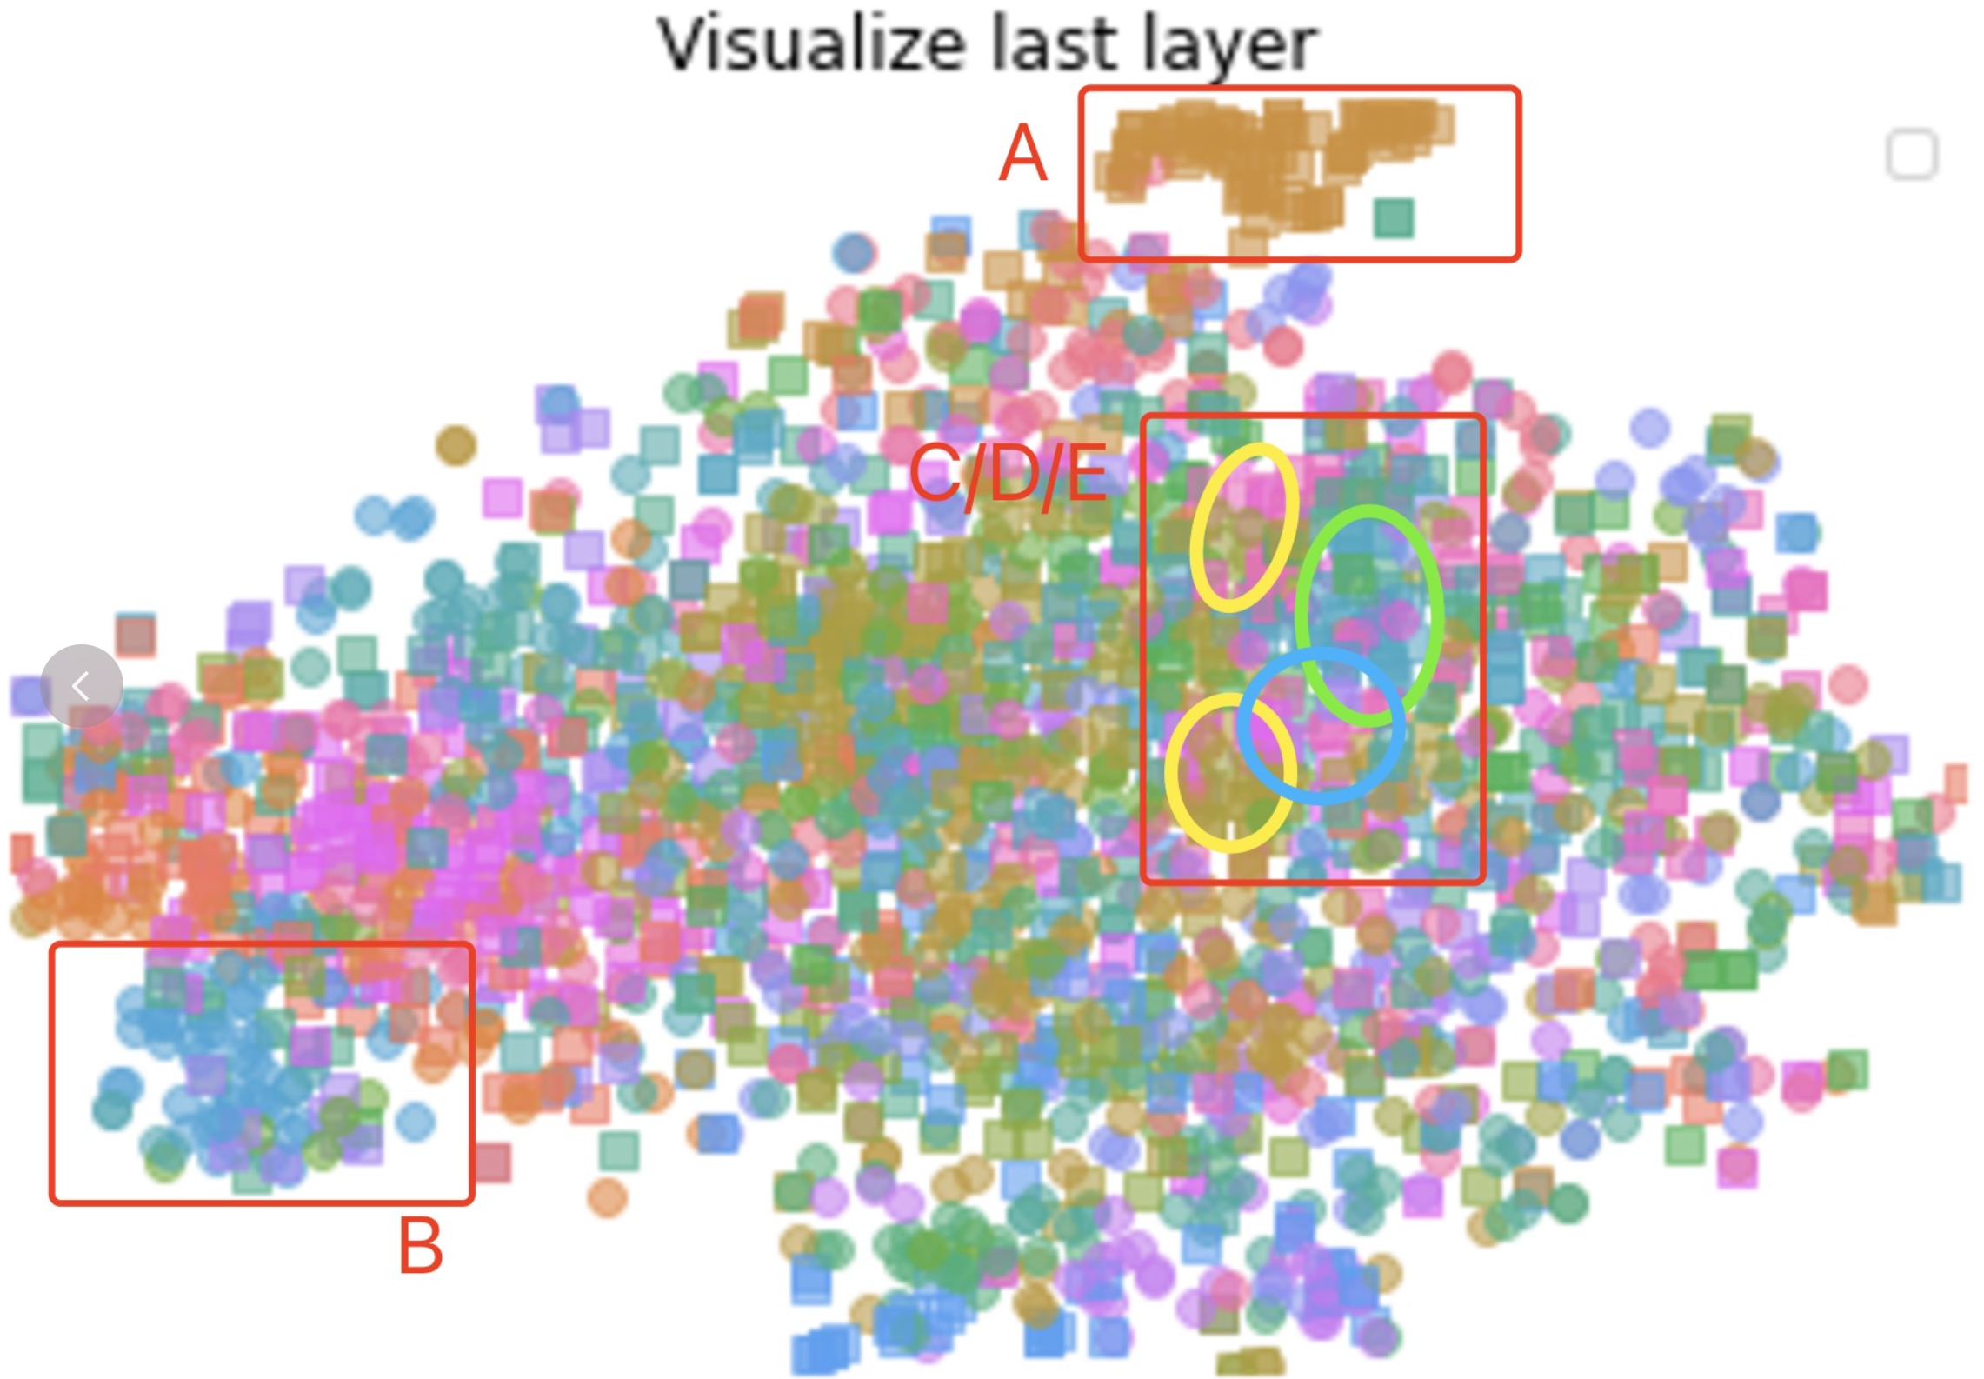
Why HD-CNN
What we did but failed.
Augment train dataset by adding pseudo dataset
Residual term
...
Inspired by the lecture of SVM,
We make the output of last layer dim reduction,
Finding out some similar categories(like the below)
are crowed together in data visualization.
Low-dim visualization of “MINIST”
Although they are clear different style(by naked eye),
CNN cannot tell.
Low-dim visualization of Train dataset

Slide 8
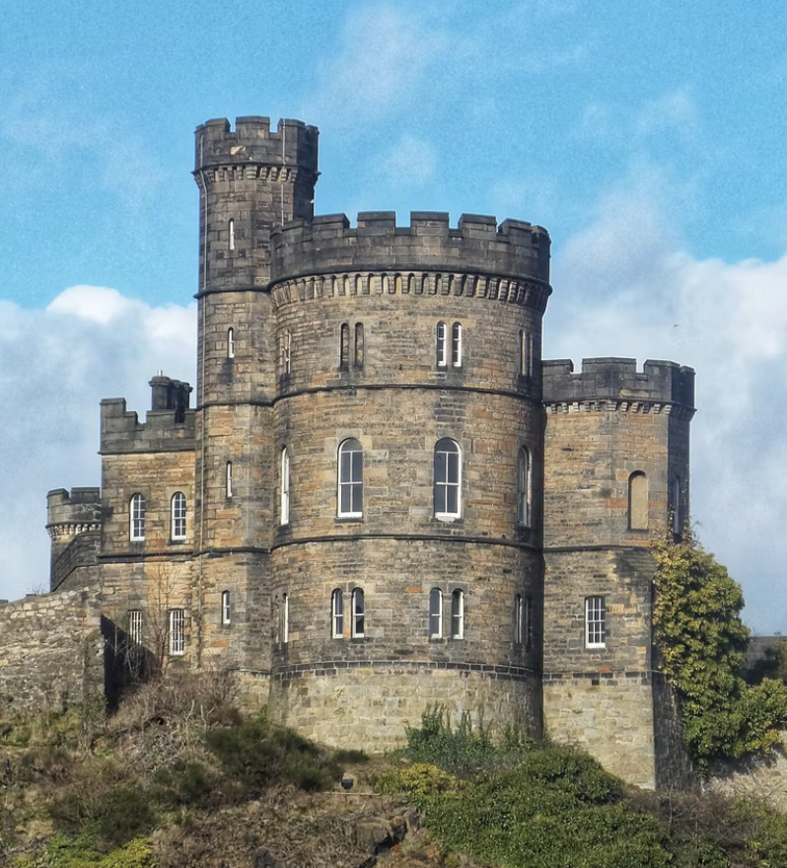
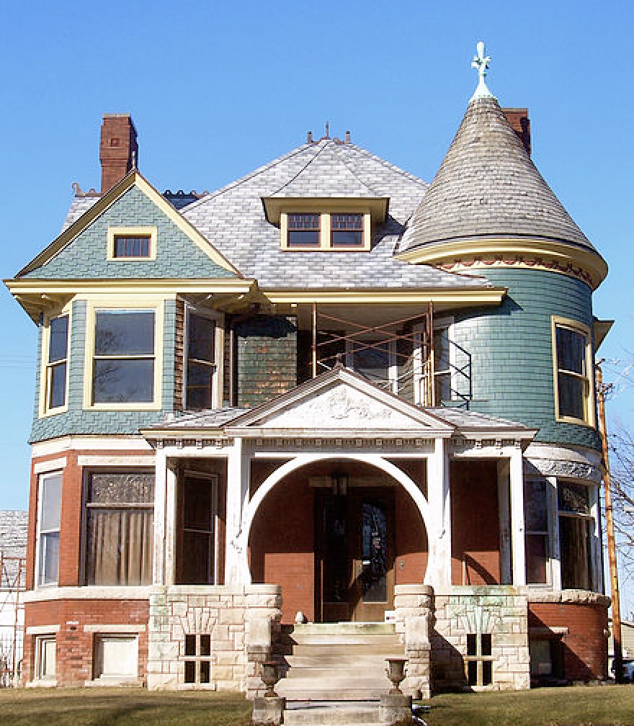
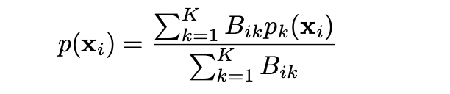
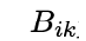
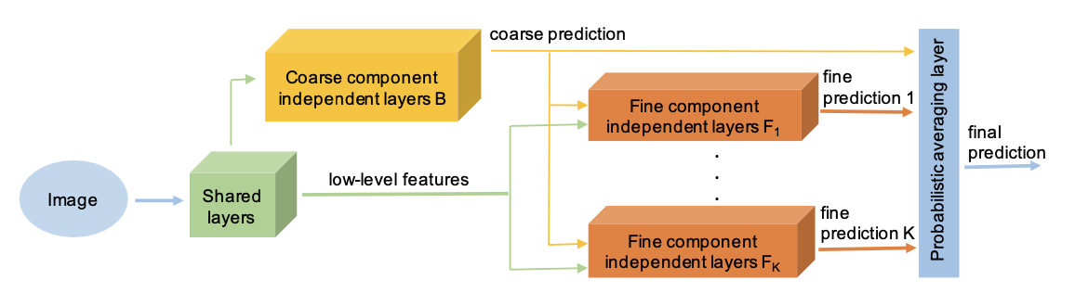

Why HD-CNN
Castle
House
Pre-define these two buildings:
Share the same kind of windows style
Different in building outline
:the probability of coarse category k
:fine category prediction
Class 1
Class 2
Raw Data
......
Class N
Fig1
Coarse Class 1
Class 1
Class 2
Raw Data
......
Window
Window
Even similar window style appears, HD-CNN could tell the classes with the help of coarse CNN result
Class N-1
Coarse Class 2
Class N
Add additional label for dataset
hierarchical deep convolutional neuralZhicheng Yan, Hao Zhang, Robinson Piramuthu, Vignesh Jagadeesh, Dennis DeCoste, Wei Di, and Yizhou Yu. Hd-cnn:
networks for large scale visual recognition. In Proceedings of the IEEE international conference on computer vision, pages 2740–2748, 2015.

Slide 9
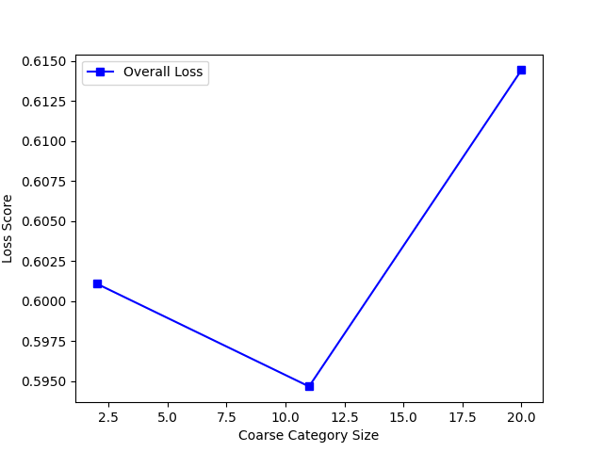
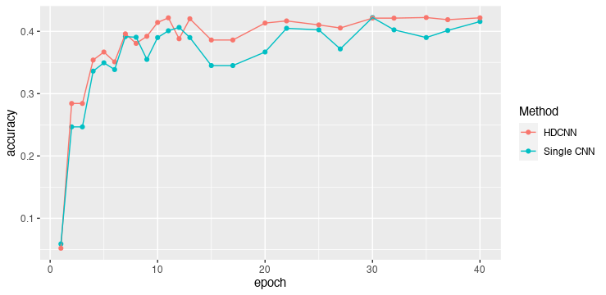
What HD-CNN Brings
The performance of Coarse CNN is important for the result, since there is not very discrete definition of “course”, we set different values for coarse number, finally figure out the best number 11.
Strength:
The accuracy of HD-CNN in 25 classification is about 10% improvement.
It applies what we thought about CNN’s struggling. (same classes are overlapped)
BUT we could find out the overall accuracy is lower than that of ”Cifar” dataset...

Slide 10
Summary & Next Step
What causes this result
Over-training & Dropout
Define the size of coarse categories manually and the performance of Coarse CNN is “Unsatisfactory”
Different categories don’t share the same amount of data
HD-CNN is not so good at similar outline (It works good in “Cifar”)
Try to solve by...
More reasonable coarse categories
Set a threshold to ensure Coarse Category Component performance
Data mining, Augment data set
1. Luminance Learning - Learning the spatial structure in image
2. Relative Position Encoding - Learning the relative position of feature
Inside the model
Outside of model

